Slide 1


MaaS Workshop
João Vieira (CARRIS)
Marco Ferreira (THALES)
12 of June, 2019
UITP GPTS

Slide 2
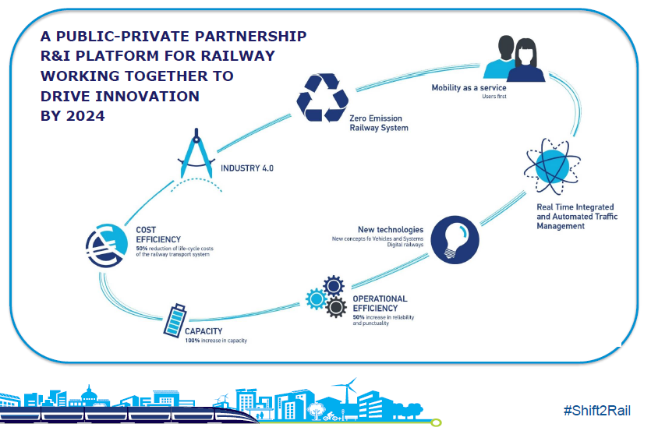


Shift2Rail Joint Undertaking and projects’ information
8 Founding Members:
Alstom, Ansaldo STS, Bombardier, CAF, Network Rail, Siemens, Thales, Trafikverket
+ Associated Members:
Including DB, SNCF, Indra, …
770M€ for Projects [2016-2022]
(450M€ from EU)
Calls For Members
Open calls (30% EU funding)
COHErent Setup and Demonstration of Integrated Travel SerVices
Shift2Rail IP4 enabling Mobility as a Service and seamless passenger experience
Total Project Value: € 1 499 906,25 (100% S2R funding)
Duration: from 01/12/2018 to 31/12/2020
Coordinator: UITP
Consortium: Aethon, Cefriel, Oltis, University of Leeds, Carris, EMT SAM (Malaga), EMEL, Via Verde, Kordis, RVS MBH, Austriatech, Fertragus
Project website: http://shift2maas.eu/
Total Project Value: € 4 039 491,45 (€ 1 795 150,00 S2R co-funding)
Duration: from 01/09/2017 to 30/06/2022
Coordinator: THALES PORTUGAL SA
Consortium: Indra, HaCon, Diginext, Network Rail, Bombardier

Slide 3
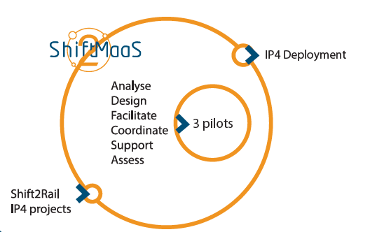
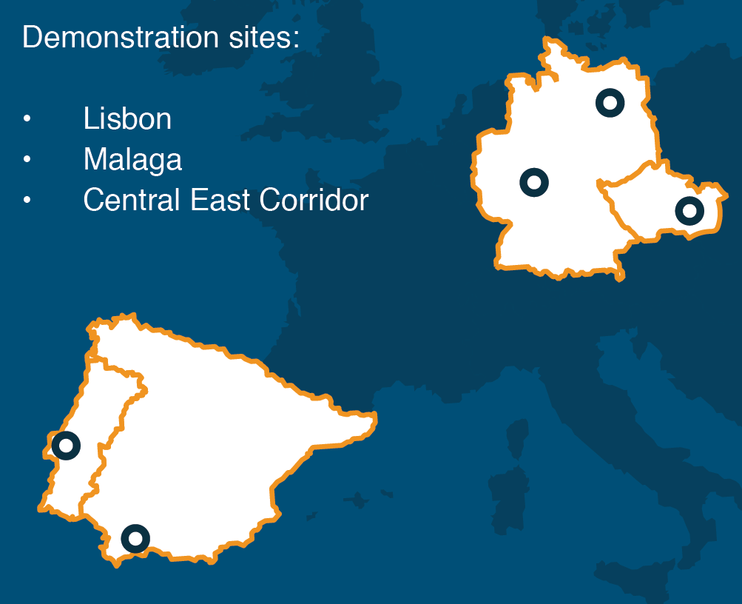
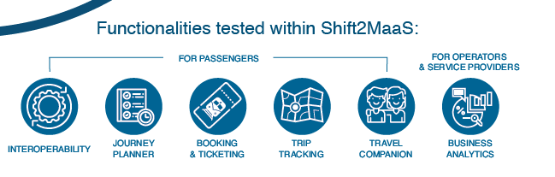
MaaS uptake – How?
Shift2MaaS is the answer
The project will demonstrate the benefits of IP4 through pilots focused on shared mobility services and seamless passenger experience, conducted in three different demonstration sites in Europe.
?
In collaboration with COHESIVE…

Slide 4
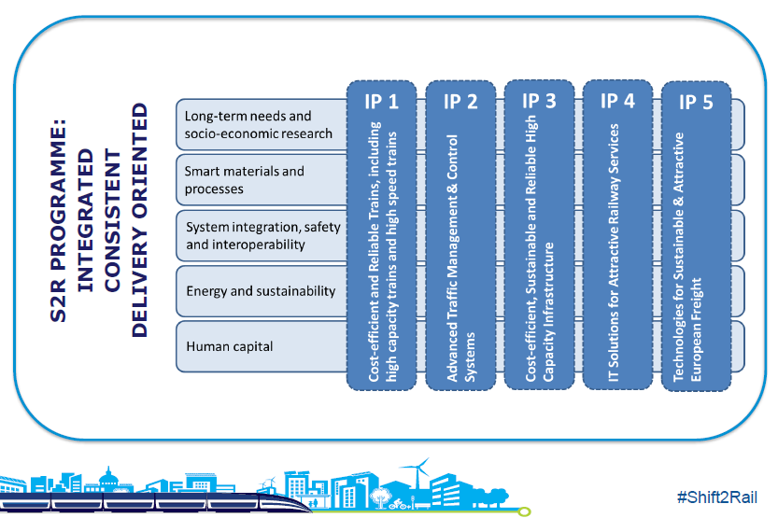
Shift2Rail Joint Undertaking
IP1: Rolling Stock
IP2: Signaling
IP3: Infrastructure
IP4: IT Solutions for passengers
IP5 : Freight
CCA (cross cutting)
Each IP between 70 to 200M€

Slide 5
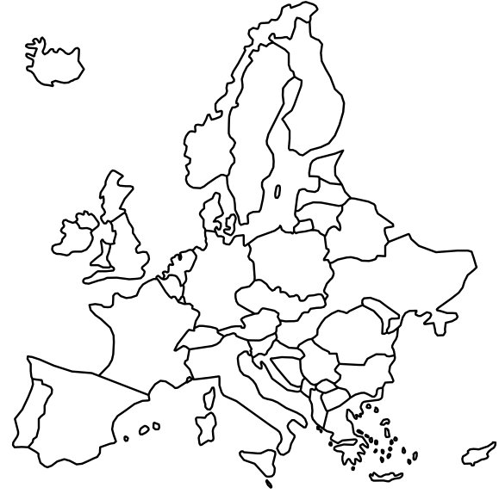











What: IP4 overview and objectives
“Towards seamless Multimodal door-to-door travelling”
Put the traveller back at the centre, ease access to rail, increasing its attractiveness
Complete multimodal travel offer connecting the first and last mile to long distance journeys
Give access to all multimodal travel services (shopping, ticketing, and information) through its travel-companion
Build an open framework providing full interoperability whilst limiting impacts on existing systems
Planning
Shopping
Ticketing
Navigating
Tracking
Aftersales
Across Europe
Across Modes
Door - to - Door
Across Services
Notes:
S2R is a Public-Private partnership, R&I plattform for railway working together to drive innovation in some year
IP4: IT Solutions for passengers

Slide 6













How the research is organised: IP4 Technology Demonstrators
“Develop a technical enabler, adaptable
to any mode, transport sector & business model”
3 Research Areas
Technical Framework
Multimodal Travel Services
Customer Experience Applications
TD 4.7 Integration & Demonstration
TD 4.1 Interop. Framework
TD 4.2 Travel Shopping
TD 4.3 Booking & Ticketing
TD 4.4 Trip Tracker
TD 4.6 Business Analytics
TD 4.5 Travel Companion
7 TDs
TD 4.1 – Interoperability Framework
TD 4.3 – Booking & Ticketing
TD 4.4 – Trip Tracker
TD 4.5 – Travel Companion
TD 4.6 – Business Analytics
TD 4.7 – Integration & Demonstration
TD 4.2 – Travel Shopping

Slide 7

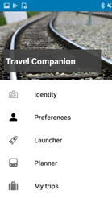








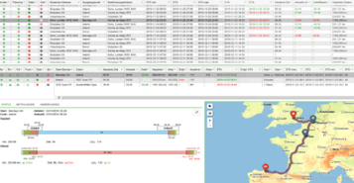




Functional view
Unique ID
Tickets stored in Virtual Wallet
Services tailored to preferences
Real time notifications
Location Based Experiences
Travel Companion
How to apply it to MaaS
?
IP4 ecosystem
Traveller services
Clearing & Settlement
Configuration of multimodal agreements
Business Analytics
Planning
Shopping
Ticketing
Navigating
Tracking
After sales
Dialogues with each provider
Integration of data
Logic for added value services
Transport providers’ functionalities
Logic and orchestration
Interoperability framework
to interact with different interfaces and data models

Slide 8






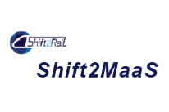

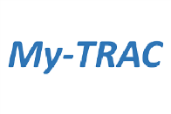


TDs and projects
Addressing all TDs
TD4 & TD5
TD2 & TD3
ITD7
TD1 & TD6
TD2 & TD3 & TD4 & TD5
2015
2016
2017
2018
2019
2020
2021
2022
ITD7
TD1
TD4 & TD5
TD1

Slide 9
From Travel companion to MaaS
MaaSIVE – one more project of IP4 ecosystem
The MaaSive Project is focused on demonstrating Mobility as a Service (MaaS) by enhancing the capabilities of the IP4 ecosystem to include
Demand Responsive Transport (First and Last Mile)
Multi-User Journeys
Enhanced Business and Contractual Management

Slide 10

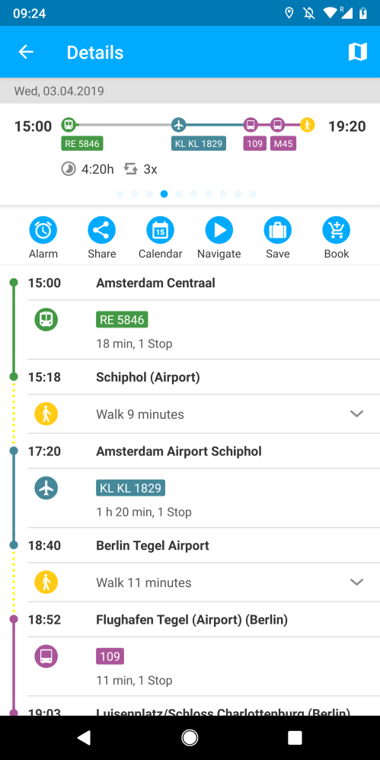
Main Innovations
One-stop shop allowing the traveller to plan, check prices, book and issue tickets that allow him to travel in a multi-modal and cross border environment
  Giving access to aggregated mobility services through a Travel Companion app
Network status aggregator calculating impacts on travellers journeys in a multimodal way
  Trip tracking orchestration
  Collection of data from the different sources
Open ecosystem
  Facilitation of the on-boarding process of transport service providers - Interoperability through Semantic technology
  Ecosystem build in the way that any MaaS provider could be the face of the ecosystem, allowing 3rd parties to enhance transport services
Location based experiences
  LBE editor allowing to create shopping experiences and gaming experiences (Augmented reality)

Slide 11
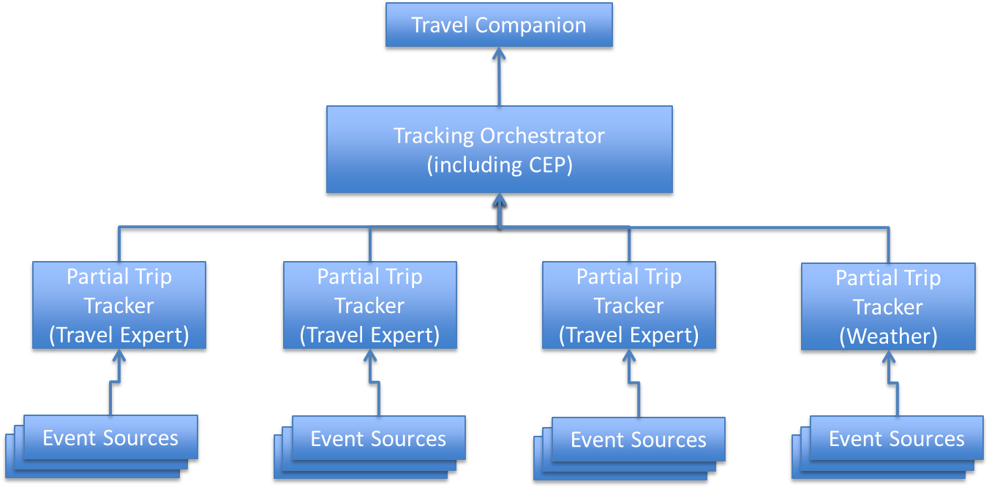
Main Innovations
One-stop shop allowing the traveller to plan, check prices, book and issue tickets that allow him to travel in a multi-modal and cross border environment
  Giving access to aggregated mobility services through a Travel Companion app
Network status aggregator calculating impacts on travellers journeys in a multimodal way
  Trip tracking orchestration
  Collection of data from the different sources
Open ecosystem
  Facilitation of the on-boarding process of transport service providers - Interoperability through Semantic technology
  Ecosystem build in the way that any MaaS provider could be the face of the ecosystem, allowing 3rd parties to enhance transport services
Location based experiences
  LBE editor allowing to create shopping experiences and gaming experiences (Augmented reality)

Slide 12
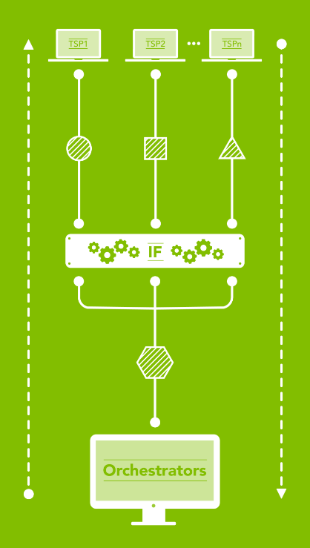

Main Innovations
One-stop shop allowing the traveller to plan, check prices, book and issue tickets that allow him to travel in a multi-modal and cross border environment
  Giving access to aggregated mobility services through a Travel Companion app
Network status aggregator calculating impacts on travellers journeys in a multimodal way
  Trip tracking orchestration
  Collection of data from the different sources
Open ecosystem
  Facilitation of the on-boarding process of transport service providers - Interoperability through Semantic technology
  Ecosystem build in the way that any MaaS provider could be the face of the ecosystem, allowing 3rd parties to enhance transport services
Location based experiences
  LBE editor allowing to create shopping experiences and gaming experiences (Augmented reality)

Slide 13
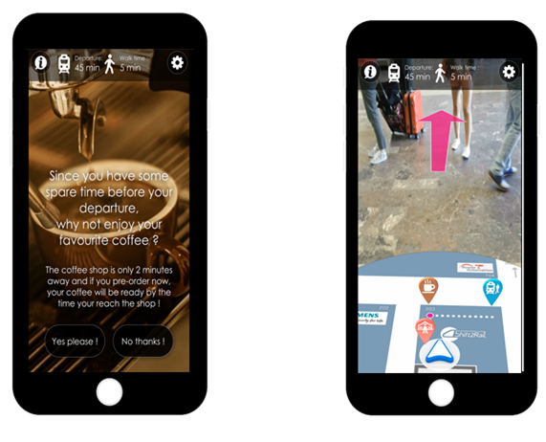
Main Innovations
One-stop shop allowing the traveller to plan, check prices, book and issue tickets that allow him to travel in a multi-modal and cross border environment
  Giving access to aggregated mobility services through a Travel Companion app
Network status aggregator calculating impacts on travellers journeys in a multimodal way
  Trip tracking orchestration
  Collection of data from the different sources
Open ecosystem
  Facilitation of the on-boarding process of transport service providers - Interoperability through Semantic technology
  Ecosystem build in the way that any MaaS provider could be the face of the ecosystem, allowing 3rd parties to enhance transport services
Location based experiences
  LBE editor allowing to create shopping experiences and gaming experiences (Augmented reality)

Slide 14
TD2 – Travel Shopping
Pan-European multimodal planning of Itineraries and Offers which fits to users needs and wishes.
Pan-European door-to-door, one-stop-shop for multimodal travel planning
Allows the user to search for the best itineraries and offers in order to fulfill their mobility needs
Travel Shopping aims to provide best routes to travellers taking into account their special needs and wishes that can be defined in preferences
Modelling of business agreements between operators and/or retailors

Slide 15
TD2 – Travel Shopping – Objectives
Provide a smart, fast and easy door-to-door Travel Shopping solution, allowing Multi-modal Journey Planning and Offer Building of Itineraries as well as associated ancillary services.
The proposed solution will:
Take into account the first & last miles via a ‘one-stop shop’ integrating urban, coach, rail and air transportation offers as well as personal and shared transport offers (e.g. Car Sharing, Bike Sharing, Car Park Management);
Enrich Journey Planning functionalities by ensuring the journey re-Accommodation (re-planning);
Refine the Offer Building with more information, alternatives, fare rules and ancillary services;
Manage failure cases;
Develop Technology Demonstrators.

Slide 16
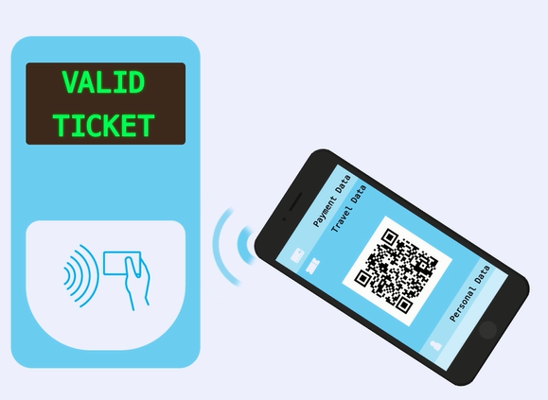
TD3 – Booking & Ticketing
Book and pay in ‘one-click’ a complete multimodal door-to-door travel journey

Slide 17



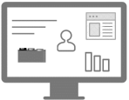






Booking & Ticketing Overview
Orchestrate multiple and parallel interactions with several providers
Book, pay & Issue through your Travel Companion
Book Ancillary services
Customer Management
Ticket management & validation
Clearing & settlement
After Sales

Slide 18
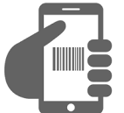
Validation
Book, pay, issue and validate using the Travel Companion
Proof of concepts with different technologies (NFC, QR codes). Should be compatible with different approaches
For the future we want to propose new technologies to reduce physical interaction (Be In - Be Out)
Integration with existing technologies
Legacy
Validation
seamless validation
Inspection
Unified entitlement
New

Slide 19
TD4 – Trip Tracking
Pan European Multimodal door2door Journey will be tracked taking trough a distributed solution an unlimited number of TSPs and other services into consideration
Keeps the traveller through his whole journey informed about any kind of travel constrains
Provides alternative routes in any kind of disruptions
Takes additional information like prognosis data into consideration

Slide 20
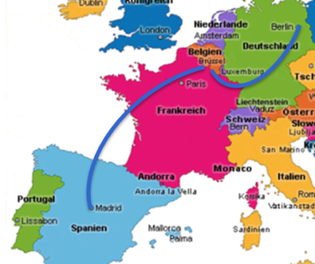
TD4 – Trip Tracking – General Architecture

Slide 21
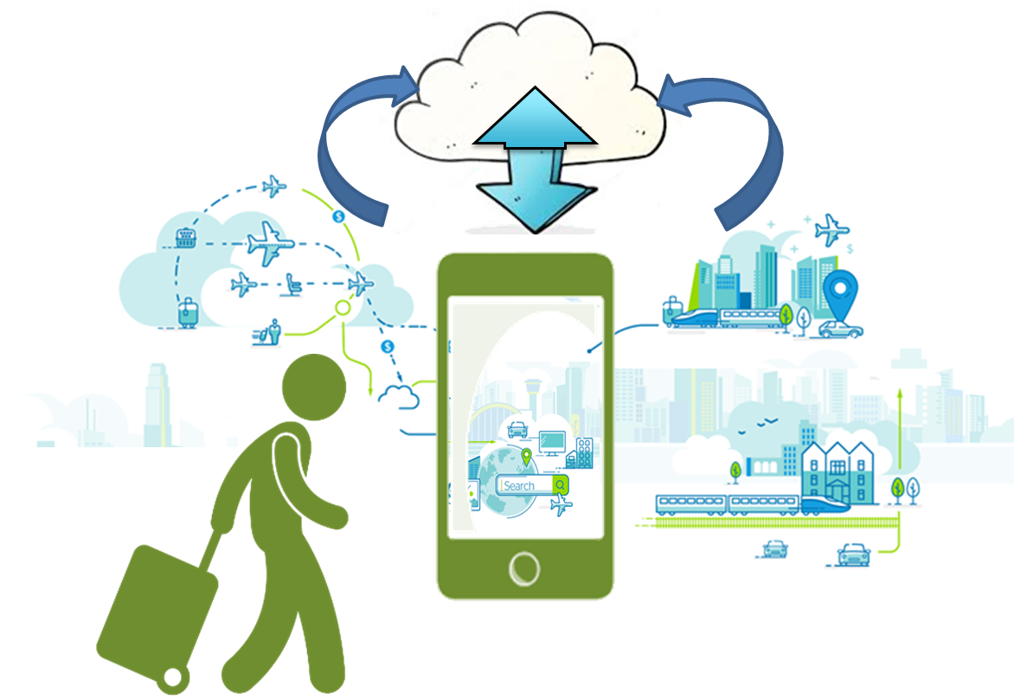
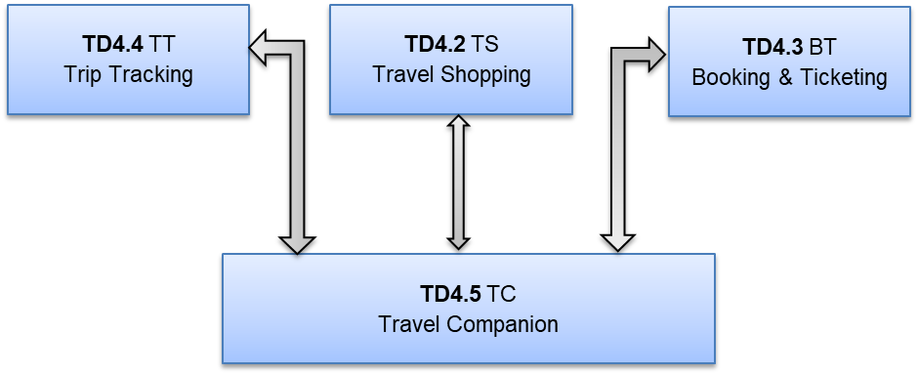
TD5 – Travel Companion: concept
The Travel companion a single mobile personal application (PA) for European door-to-door travel providing all transportation services.
With a secure cloud storage (“cloud wallet”)

Slide 22
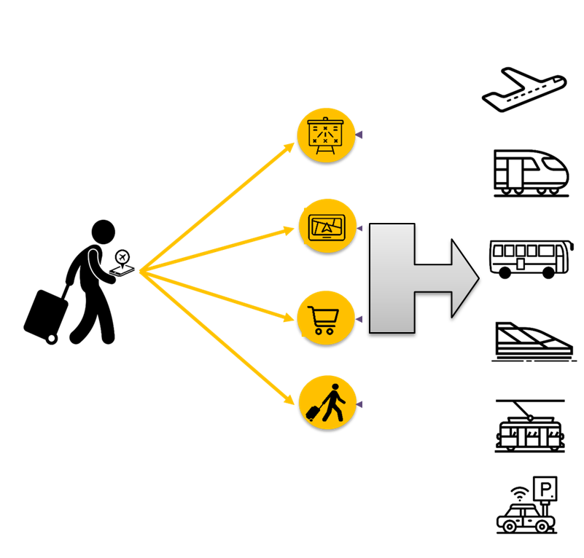
TD5 – Travel Companion : objectives
TD5 – Travel Companion
Central access point for all Shift2Rail IP4 mobility functionalities
Provide a single mobile personal application for travellers
Provide UI for shopping, booking, feedback and notifications
Provide a cloud Wallet, a virtual cloud space to store dedicated User Account data, electronic payment, preference and travel wallets.
Provide navigation assistance at interchanges
Provide novel forms of Location based experiences

Slide 23


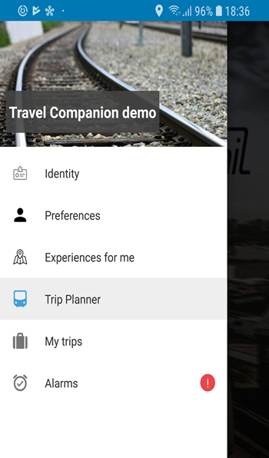
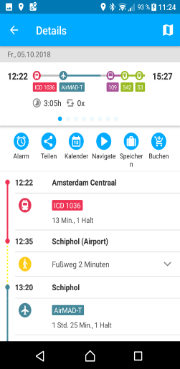
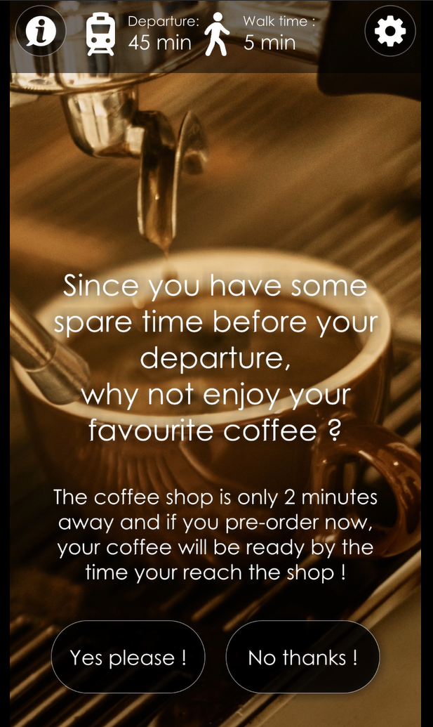
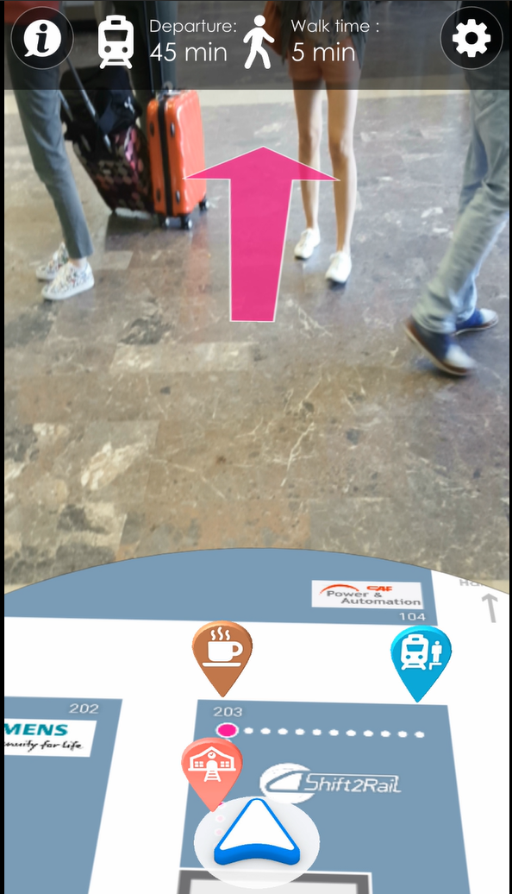
TD5 – Travel Companion : functionalities
  Manage User Account stored in the Virtual Space of the Cloud Wallet
    Create account
    Mange preferences
  Plan a trip
    Book and shop an itinerary
    Manage Token and Embodiment
    Receive notifications (new platform, new time, new itinerary ) real time information and disruptions about the itinerary to the travellers
    Perform basic after sales ( cancellation, refund…)
    Collect feedback data to the Trip Tracker to improve real time information;
    Provide guidance and interchange navigation functions for indoor/ outdoor travel episodes.
  Create and experience rich content through novel forms of travel Location Based experiences
Cloud Wallet

Slide 24
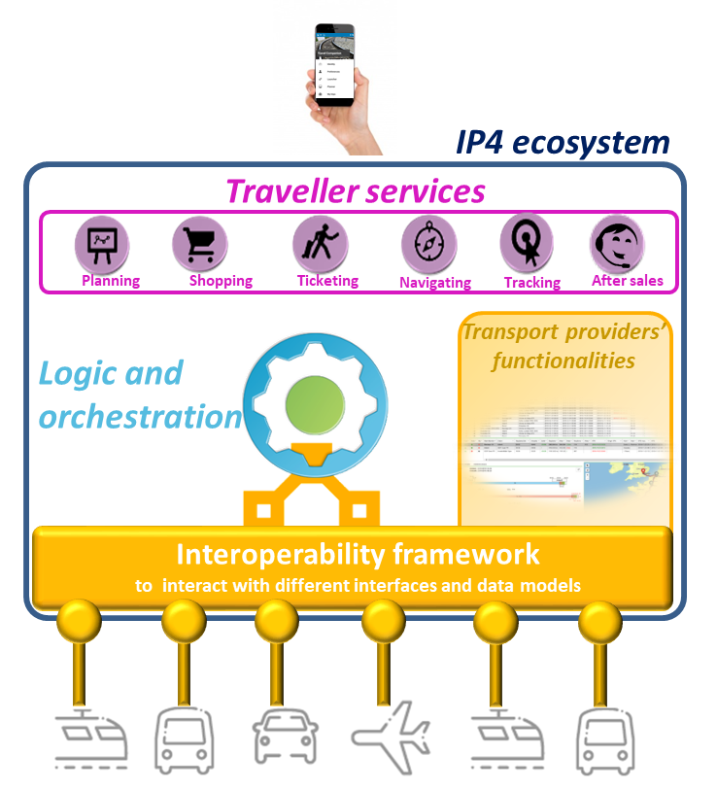
TD1 – Interoperability Framework
Foster the digital transformation of the transport ecosystem and facilitate interoperability among heterogeneous systems

Slide 25






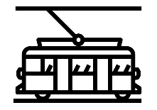


IF: Approach
Without Interoperability Framework….
Interface A
Journey involves A-D-F
Interface B
Journey
Planning
Interface C
Transport Service Providers (TSP)
Interface D
Booking
Interface E
Interface F
Shopping, Booking & Ticketing, Trip Tracker components need to know for each TSP: end point, communication protocol, services provided, data model, etc.

Slide 26
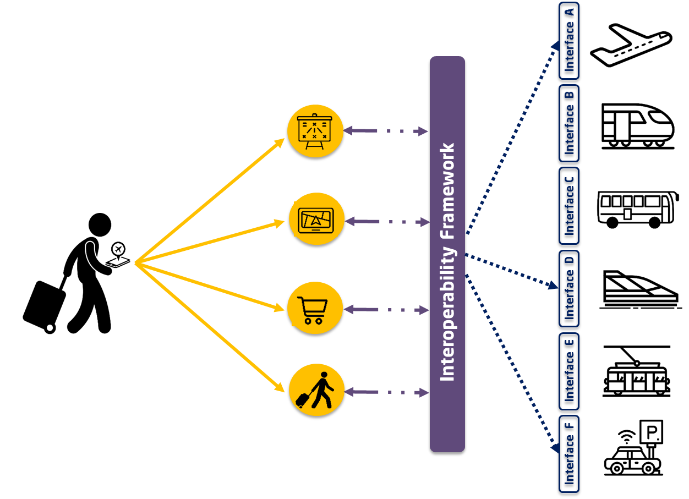

IF: Approach
TRAVELLER
Unique access point for all services, don´t need to know how to reach each TSP
BENEFITS
IP4 APPLICATIONS
(SHOPPING, TICKETING, etc.)
TSP / OPERATORS
The IF offers them functionalities to:
Mask complexity of interoperability
Identify TSP
Know how to communicate with them: web service/API interfaces, communication protocols
Reduce to a minimum their to store data from the TSP
Heterogeneous systems interoperating without changes in their interfaces
No need of adopting standards to join the ecosystem
Join the ecosystem and describe the services they offer
Can be reachable by the IP4 applications

Slide 27
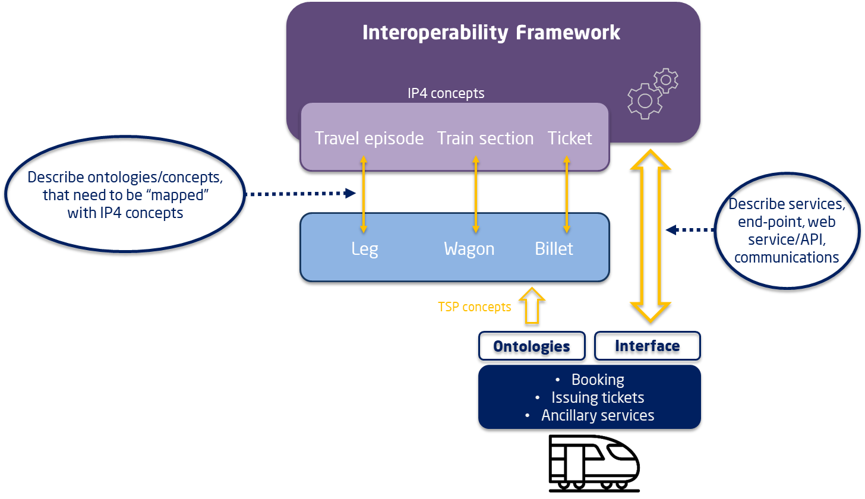
Semantic Interoperability
« semantic interoperability » is the ability to automate the conversion across different data representations of common concepts of a given domain
Common knowledge is described formally in machine-readable first order logic statements (ontology) that are independent of how it is represented in specific data format
Specific data representations are annotated
with terms of the ontology, associating the
data structures to their interpretation

Slide 28


TD6 – Business Analytics - overview
Take advantage of the data existing/generated in the ecosystem and provide useful information for travelers and TSP
Punctuality
Most used modes
Incidents in the line
Service quality
Crowded stations
Favourite destinations
Revenues per mode
  Operational data coming from TSP’s systems
  S2R applications data
  Data coming from travellers
  Other external data: open data, social network data
  Big Data architecture to treat and analyze data
  GDPR consideration: anonymization techniques
  Virtual Reality/Augmented Reality
  Interactive and dynamic visualization capabilities
  Develop descriptive, predictive and prescriptive analytics
DATA
MANAGEMENT
ANALYTICS
VISUALIZATION

Slide 29
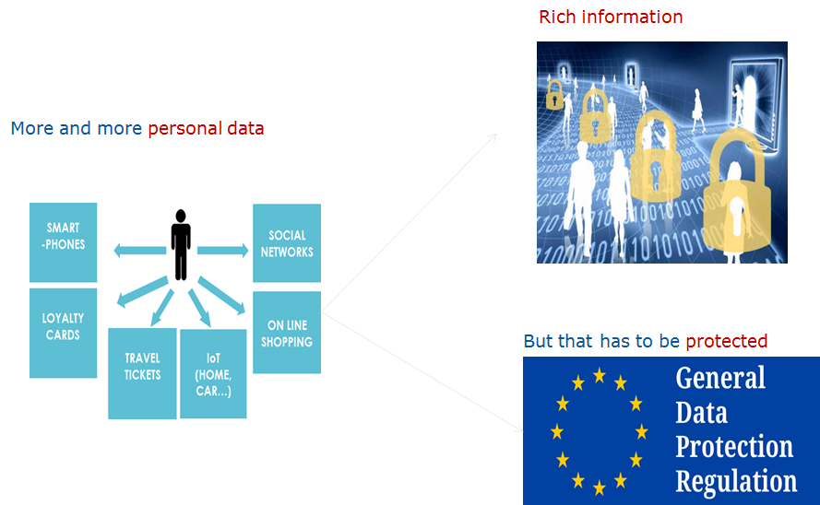
TD6 – Business Analytics
Data management - Anonymisation
Answer the European data privacy regulation GDPR (General Data Protection Regulation) and more generally confidential issues in the context of Transportation digital transformation
Reduce the risk of privacy and confidential breaches
Develop algorithms to answer three anonymisation needs

Slide 30

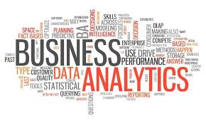



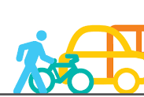
TD6 – Business Analytics
Examples of analytics
Assets management
Monitoring stations; optimize maintenance; optimize passenger flow
Optimize revenue collection
Fraud control
Characterize problems/incidences and impact depending on type of day
Demand Management
Mobility patterns, demand prediction, OD Matrix
Correlate demand and day type, events, weather etc
What-If analysis, support to the deployment of strategies and offer-demand adjustment
Control passenger entrance at stations
Passenger &
Services
Management
Patterns of transport usage depending on sociodemographic profiles
Business KPI: cost and revenues
Loyalty programs, ancillary services, preferred bookings etc
Multimodal
Combining data from different TSP, users and IP4 services:
  Travel patters: preferred multimodal itineraries etc
  Multimodal KPIs
  Resource management depending on other modes

Slide 31
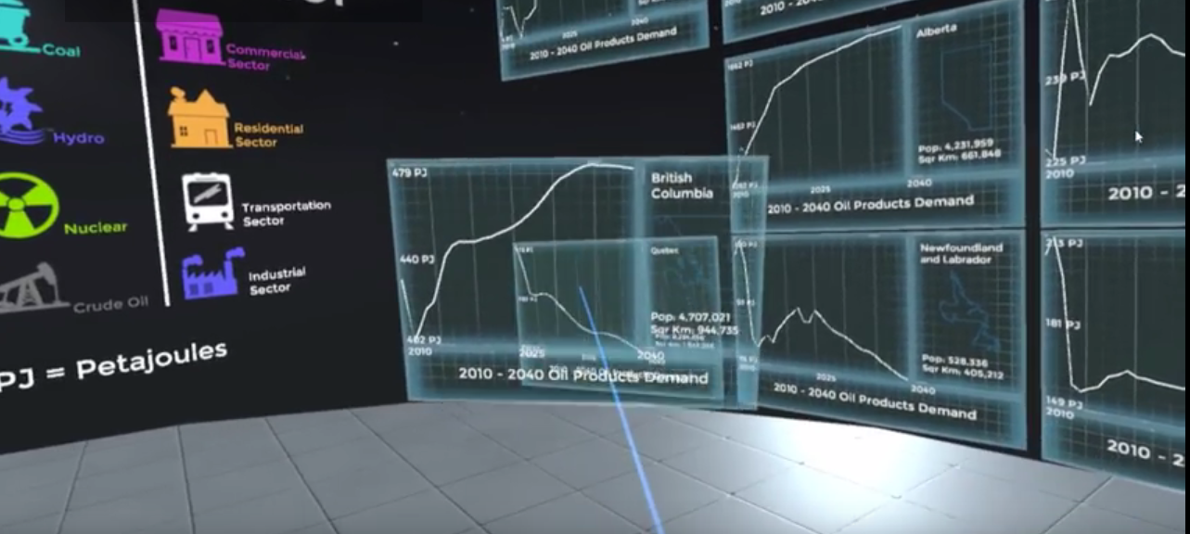

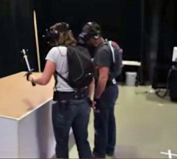
TD6 – Business Analytics
Visualization
Virtual Reality
Take benefit of all virtual space to visualize and analyze more and more data by
  Visualize dynamic data: spatio-temporal data
  Superposing data in the space for comparisons
Define new concepts for user interaction, data presentation and working flow
  Cooperative interaction
  Virtual meeting

Slide 32
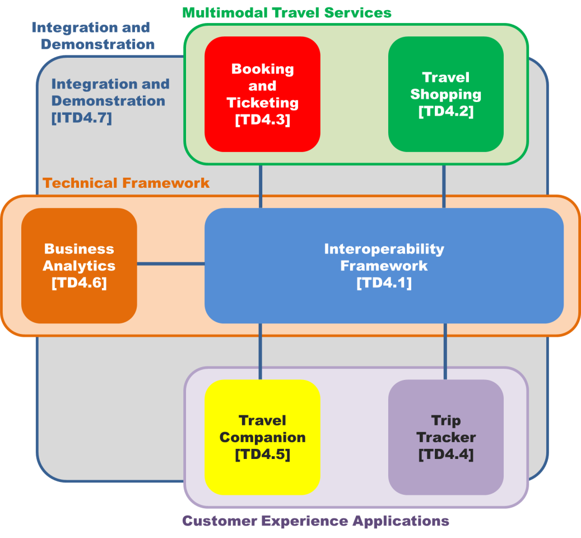

iTD7 – Integrated Technical Demonstrator

Slide 33
iTD7 – Objectives:
Guarantee a Technical Coordinated Interface amongst the different projects S2R/IP4
Ensure Engineering Consistency and documentation coherence
Promote convergence of all IP4 technical demonstrators
To develop plausible Use Cases to incrementally demonstrate the integrated functionalities
Integration an Testing of the different IP4 technical demonstrators
Support cross-TD technical issues solving
Dissemination and Communication of results
Demonstrations definition, preparation and execution
Assess possible Business Model(s)

Slide 34
Integrated
Planning
COHESIVE
(iTD7)
CONNECTIVE
(TD1 & TD6)
CO-Active
(TD2-TD3)
ATTRACKTIVE
(TD4-TD5)
MaaSIVE
(TD2-TD5)
CFMs 2020
2018
2019
2020
2021
Innotrans 2018
Innotrans 2020
Alpha release
Beta release
FREL
Running CFM
CREL
AREL
FREL
FREL
FREL
CREL
FREL
Q3
Q4
Q1
Q2
Q3
Q4
Q1
Q2
Q3
Q4
Q1
Q2
Q3
Q4

Slide 35

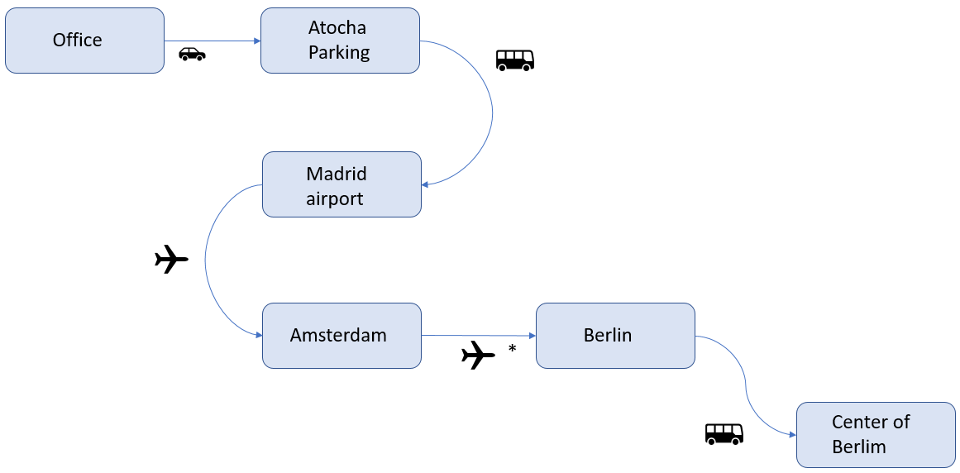



First IP4 demonstration – Innotrans2018
USERS PERSPECTIVE
Office in Madrid
Users register through their travel companion (TC) or login. Create their profile and describe their preferences
Madrid Airport
“Shop” a trip within one origin and destination, selecting the best one among multiple offers (modes, prices, timetables)
Amsterdam
Flight cancelled!
“Book” the selected offer, pay and “issue” the tickets for the segments available; store the trip details and the tickets in the Virtual Wallet. Travellers can add ancillary services, as required (WiFi, lunch etc)
Berlin
Alternative:
Shift to rail
Travellers will be informed of a disruption affecting the planned trip, such as flight cancellation. Alternatives will be provided to reach the destination, as well as management of Passenger’ Rights (Cancelation, Refund, etc.)
InnoTrans
Users can improve their experience:
Navigation at interchanges
Location based experiences
(information, games, discounts, etc.)
Travellers can consult trip details at any time, and retrieve the virtual tickets to validate at each travel segment.

Slide 36
First IP4 demonstration – Innotrans2018
Video

