Slide 1

My-TRAC for UITP summit
Grant Agreement Number : H2020 – 777640
June 11, 2019
Ismini Stroumpou
AETHON Engineering Consultants P.C

Slide 2
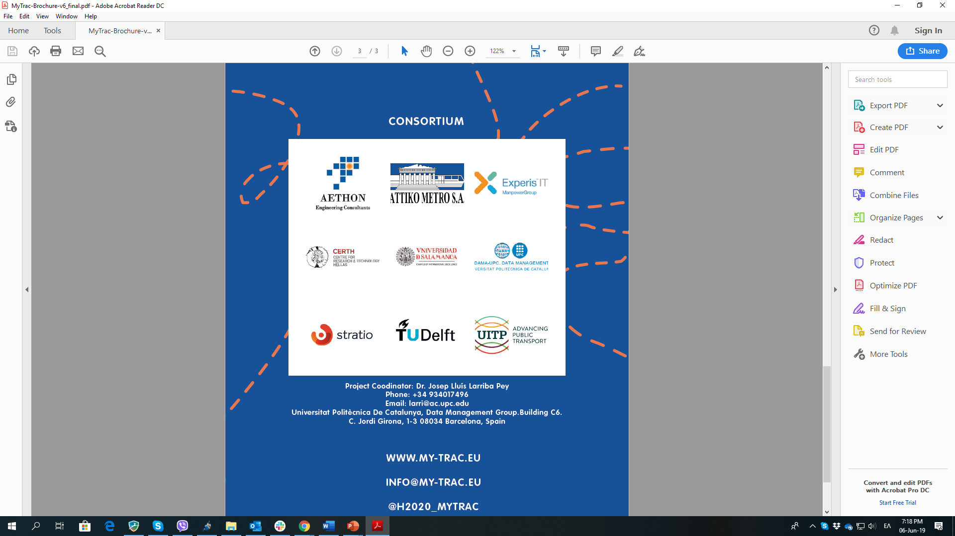
Starting Date: 1/9/2017
Duration: 37 months
Grant agreement ID: 777640
Overall budget: € 3 494 476,25
UPC
EXPERIS
USAL
AETHON
AMETRO
CERTH
DUT
STRA
UITP

Slide 3
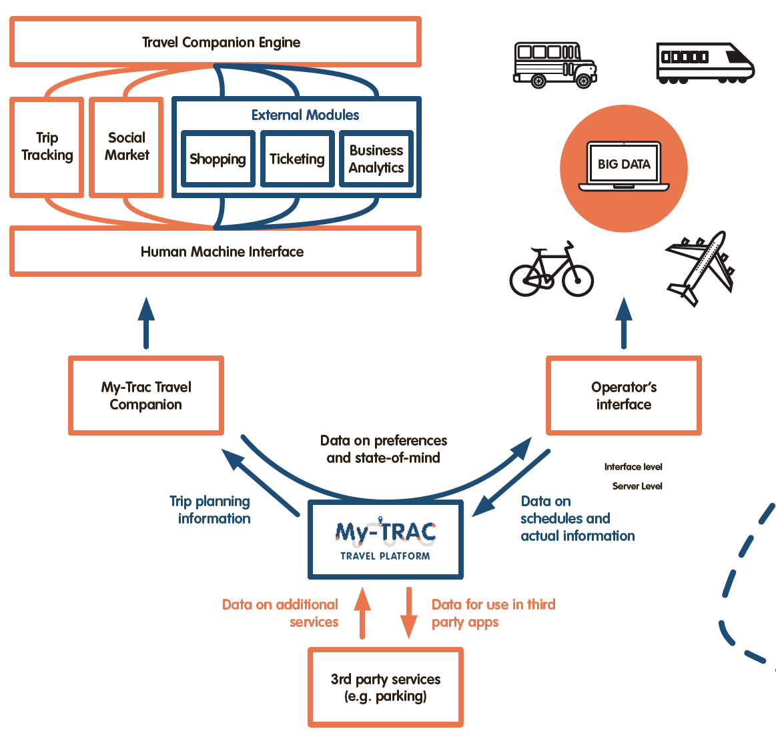



Grant Agreement Number : 777640

Slide 4
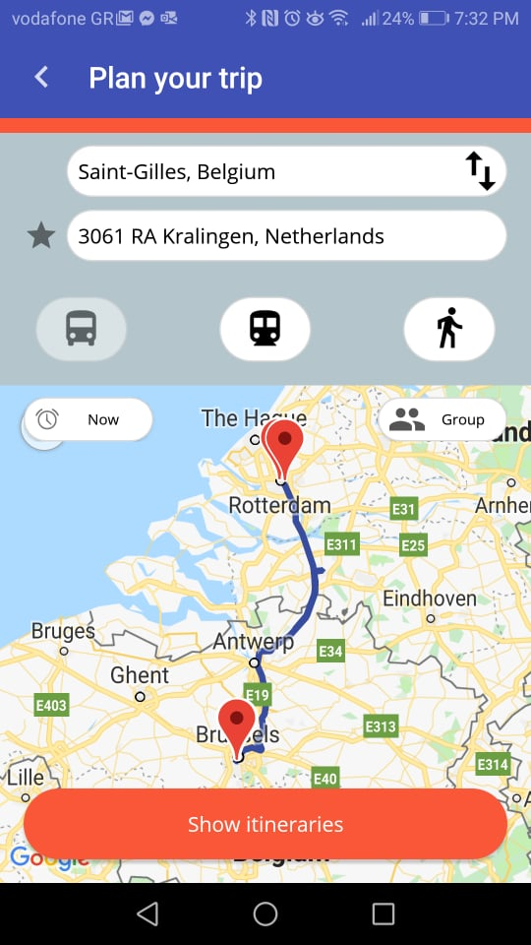
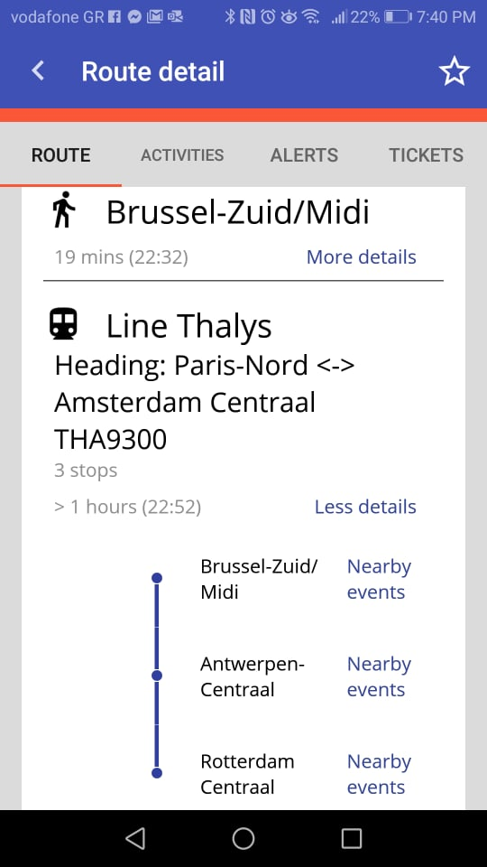
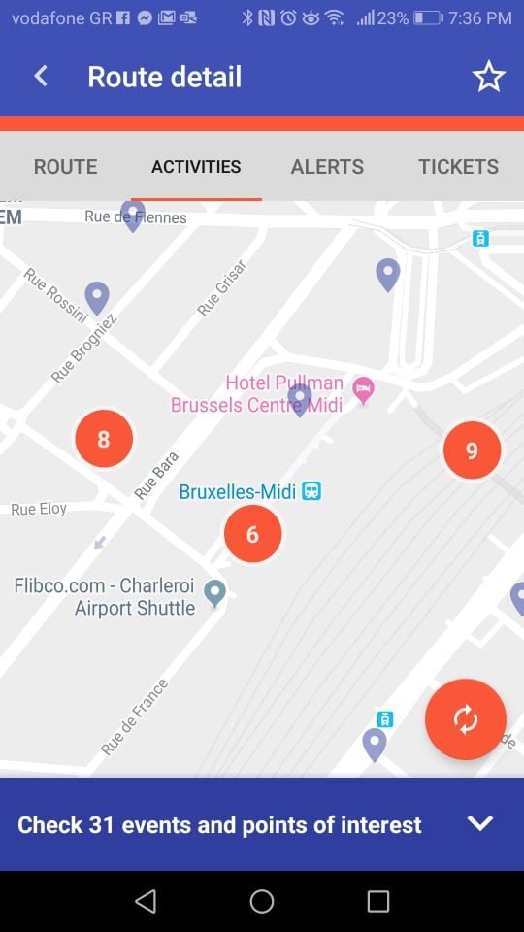
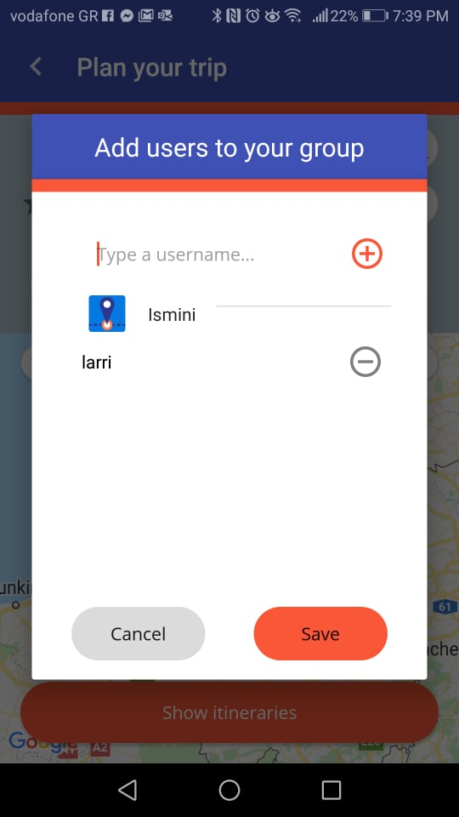
+ MaaS

Slide 5

+ MaaS
GTFS from TSPs
3rd parties data (e.g. parking, events)

Slide 6
Map of My-TRAC technologies
Profiling of users based on questionnaires
Questionnaires conducted, social data
WP2, WP3
Travel Data Models
Creation of models
User-centered Behaviour Models
Spain
Netherlands
Greece
Portugal
Technologies:
    Scale in the Cloud
    Support backend heavy duty
    Mobile App activity
Technologies to support implementation
WP4, WP5
Mobile and Web Apps implementation
My-TRAC travel companion: Travel Planning, Tracking and Recommendation, Social Travel, Operators interaction

Slide 7
My-TRAC Mobile App
My-TRAC for Operators
My-TRAC
technology
platform
My-TRAC technology platform
My-TRAC technology platform
User behaviour prediction
User behaviour prediction
Travel recomm.
Travel recomm.
Storage for data from TSPs, GTFS
Storage for external Data
User behaviour models
Travel analytics models
External Data from TSPs
Other external Data

Slide 8
Data
M18 M18 M36
Profiling user through App
Data from questionnaires
Anonymous profiling of users
Tracking the user
Post Pilot questionnaires
Data from TSPs
GTFS
Smartcard Data
Open Street Maps
POIs
Events
Data from external sources

Slide 9



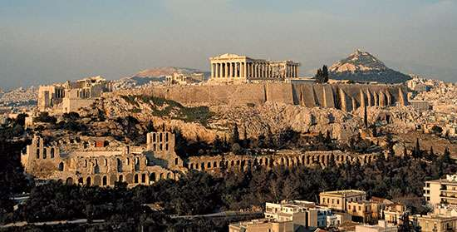
What next?
Pilots of My-TRAC

