Slide 1
IMOVE Project Overview
Marco Gorini, Softeco Sismat SRL

Slide 2
IMOVE
Unlocking Large-Scale Access to Combined Mobility through a European MaaS Network
Project Synopsis:
Innovative concepts, systems and services towards 'mobility as a service'
MG-6.1-2016 call, one of the three selected projects (IMOVE, MaaS4EU, MyCorridor)
Research and Innovation Action (RIA)
30 months duration: 1.06.2017 – 30.11.2019
3.69 M€ cost, 3.39 M€ EU grant
Consortium: 15 organizations, 6 countries
research: AICENTER (CVUT), I-SENSE (ICCS), RISE
ICT/consulting: Softeco Sismat, Mosaic Factor, FIT, Vectos
mobility: Transport for Greater Manchester, 5T, Municipality of Turin, UBIGO, URBI, Vasttrafik, EMT Madrid
stakeholders’ association: UITP
© Ruter AS / Redink Hampus Lundgren

Slide 3
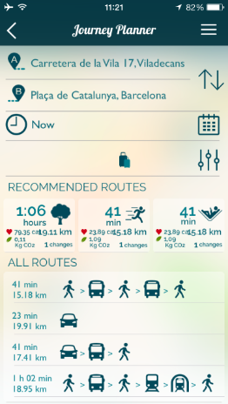
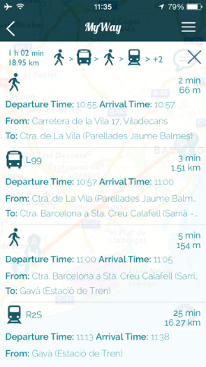
Objective and key challenges
To accelerate the deployment and unlock the scalability of MaaS schemes in Europe, paving the way for a “roaming” service for MaaS users at the European level
Main streams of research:
Measures, Policies and Strategies
Heterogeneous organizational/regulatory frameworks, unclear business models ➔ Scalability Unlockers: to enhance the framework conditions for MaaS development and operation (business models, guidelines, best practices)
Enabling Technologies
A broad offer of services/products already on the market (mobile apps, travel planners, e-ticketing, APIs, MaaS Platforms) ➔ Software Enablers: to integrate existing functionalities, enhance interoperability and facilitate cross-border roaming of MaaS schemes

Slide 4
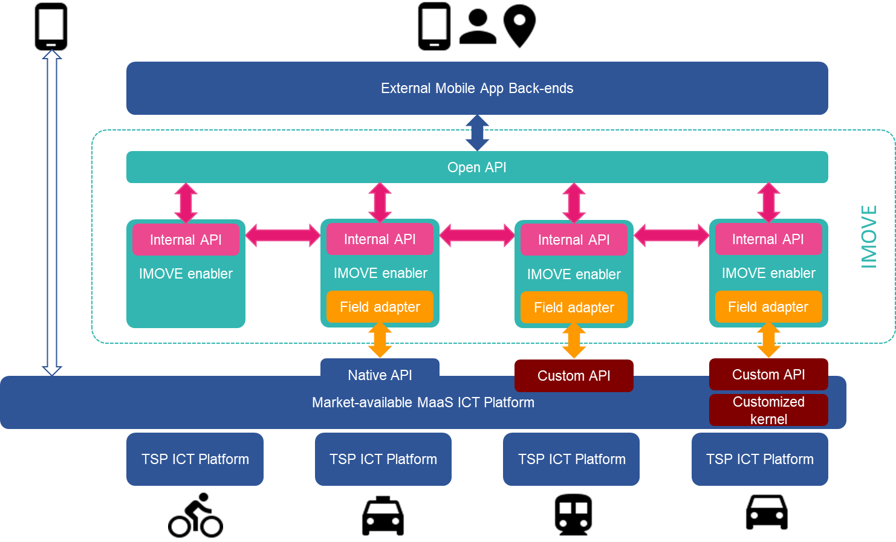
Tech enablers: the IMOVE Software Enablers
Modular “building blocks” wrapped around basic MaaS functions
Can be «chained» together to support various MaaS operational tasks
Lay down a common framework to ease interoperability between roamed platforms
IMOVE Software Enablers
Identity Manager (single service sign-on)
User Tariffs/Price Manager
User Preferences Manager
Mobility Organizer (combined solutions)
Booking Manager
Mobility Tracker (mobility patterns, analytics)
Notification Manager (events)
Incentives & Engagement Manager
Roaming Manager (cross-MaaS interoperability)
IMOVE
Roaming
IMOVE

Slide 5
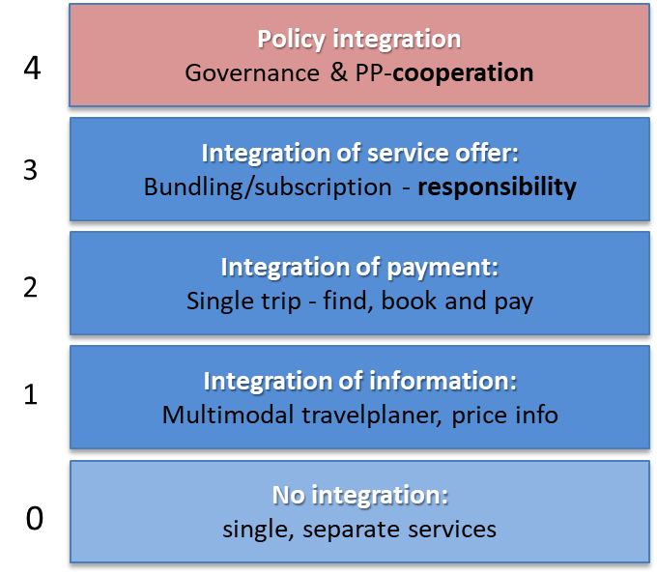
Validating MaaS enablers: the IMOVE demo sites
A mix of transport environments: metropolitan / mid-size urban / rural areas
“Living Lab” approach: involvement of local stakeholders
Roaming across sites/operators
Göteborg
MaaS provider: local providers (SpaceTime, SmartResenär) + Västtrafik
Integration Level: initial L0, target L2-L3-L4
3 distinct pilots: PT + parking services (integrated ticketing); combined mobility solutions for residents/ tenants (132 new apartments with combined mobility services instead of parking); B2B combined mobility for business trips
Berlin
MaaS provider: URBI (IMOVE partner)
Integration Level: initial L1, target L3
integration of at least one MSP per transport mode. Cooperation with PT: adaptation of APIs for integrated ticketing system, reselling of PT tickets through URBI app
Turin
MaaS provider: URBI (IMOVE partner)
Integration Level: initial L1, target L2
Focus on home-2-work / work-2-work mobility: General Motors employees + Municipality employees. Strong role of PT (GTT), engagement of private MSP (car-/bike-sharing) ongoing
Manchester
MaaS provider: Mobilleo
Integration Level: initial L0, target L3 (medium term)
Several focus groups with local stakeholders (MSPs, users). Analysis of potentially applicable business models (public vs. private)
Madrid
MaaS provider: EMT Madrid (proprietary platform)
Integration Level: initial L1, target L2 (+ policy integration)
“MaaS Madrid” project as part of the Air Quality Plan of the City: PT, Car-Sharing, Scooter-sharing, Bike-Sharing, PMV

Slide 6
Lessons Learned (so far)
MaaS is a very promising transport paradigm, but there are still barriers that slow down the fulfillment of its full potential:
Level of market readiness (expectations vs. practicalities)
Perception of risks and uncertainties among ecosystem actors
Agreements between public and private MSPs (car-/bike-sharing, taxis) may be slower than planned
Timing of tendering processes
Challenges related to existing institutional frameworks
Key Enablers:
Role of Public Transport Authorities is crucial for a calibrated and trustable offering
Substantial readiness of technology (core levels L1-L3)
Engagement of MaaS tech providers from the start of the initiative
Collaboration (e.g. sharing of information) between MaaS experiences

Slide 7
Thank you
www.imove-project.eu
@H2020_MOVE
#H2020_IMOVE
Marco Gorini
SOFTECO SISMAT SRL
Via De Marini, 1 - WTC Tower,
16149 Genova, Italy
marco.gorini@softeco.it

