Slide 1



Fostering the adoption of Galileo for Mobility as a Service
This project has received funding from the European Global Navigation Satellite Systems Agency under grant agreement No 776381

Slide 2


GALILEO, an enabler for improved MaaS

Slide 3












Slide 4
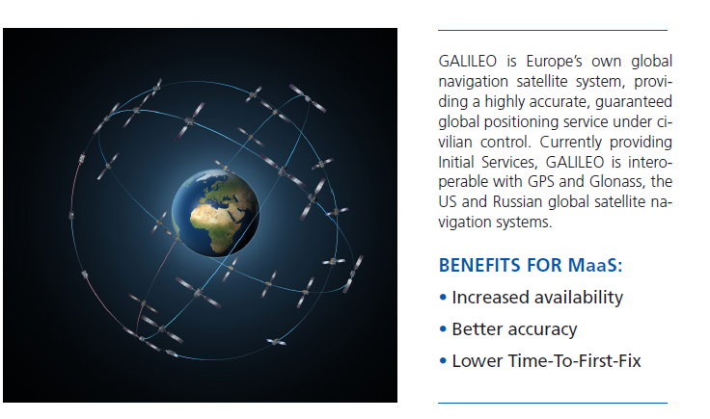

Slide 5
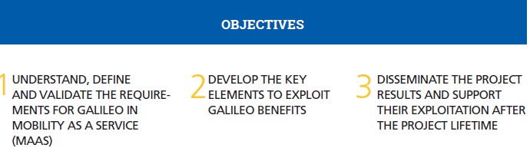
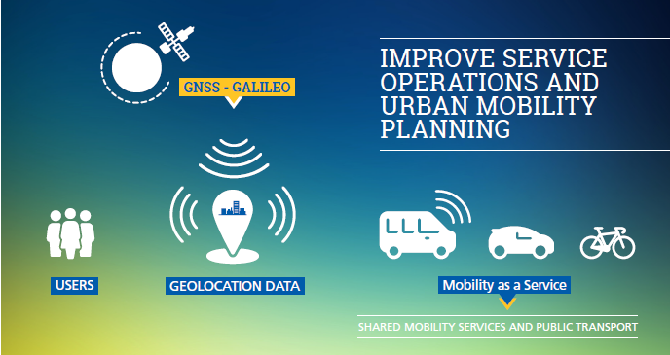

Slide 6


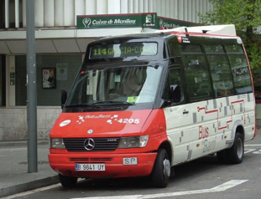
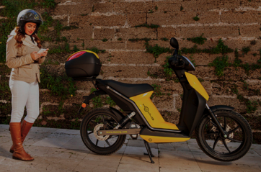
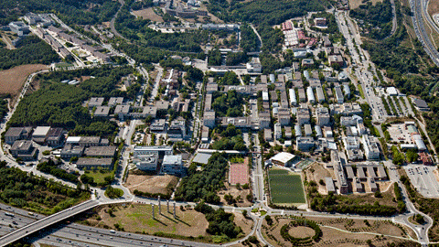
Pilots Barcelona
Public transport on demand
MaaS aggregator
Autonomous vehicle on campus

Slide 7

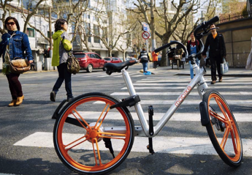
Pilot Paris
Vehicle sharing

Slide 8
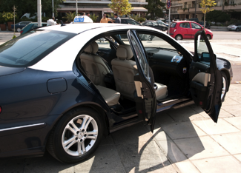
Pilot Thessaloniki
Shared taxis

Slide 9




